Slide 2
Announcements
Group project deadline is TONIGHT
Submit at wdd.io/go/project-submit.
Mid-semester feedback soon!
Is there any topics / improvements you want to see? wdd.io/go/feedback

Slide 3
Rapid Prototyping
Week 7

Slide 4

If you haven’t downloaded XD

Slide 5

goo.gl/rEJPmP

Slide 6
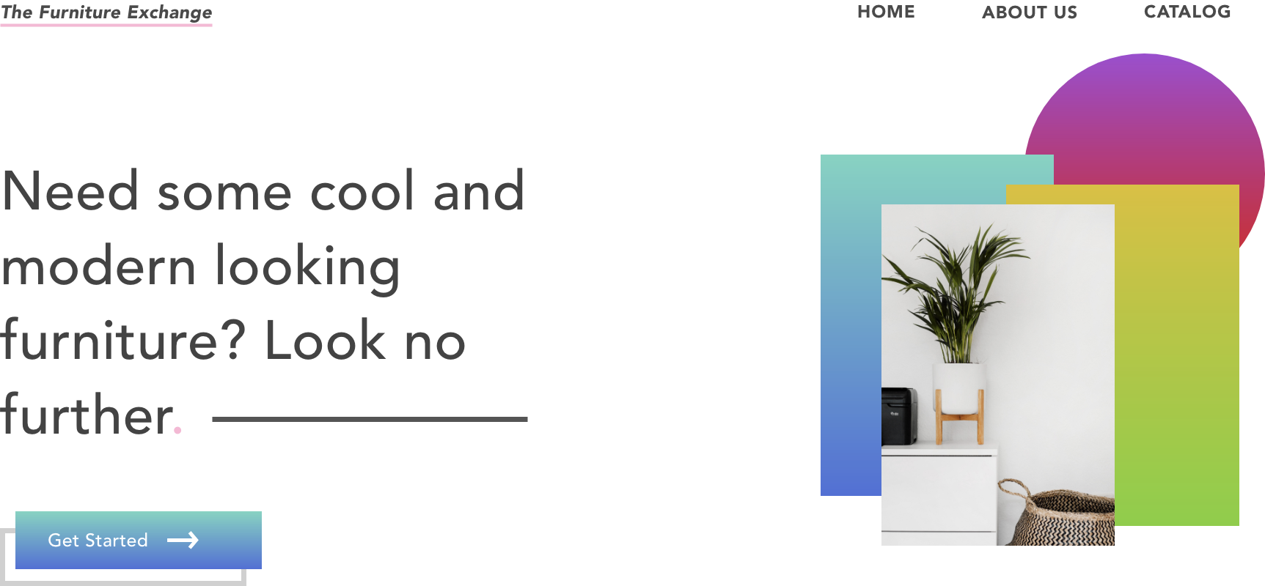
What you learned last week

Slide 7
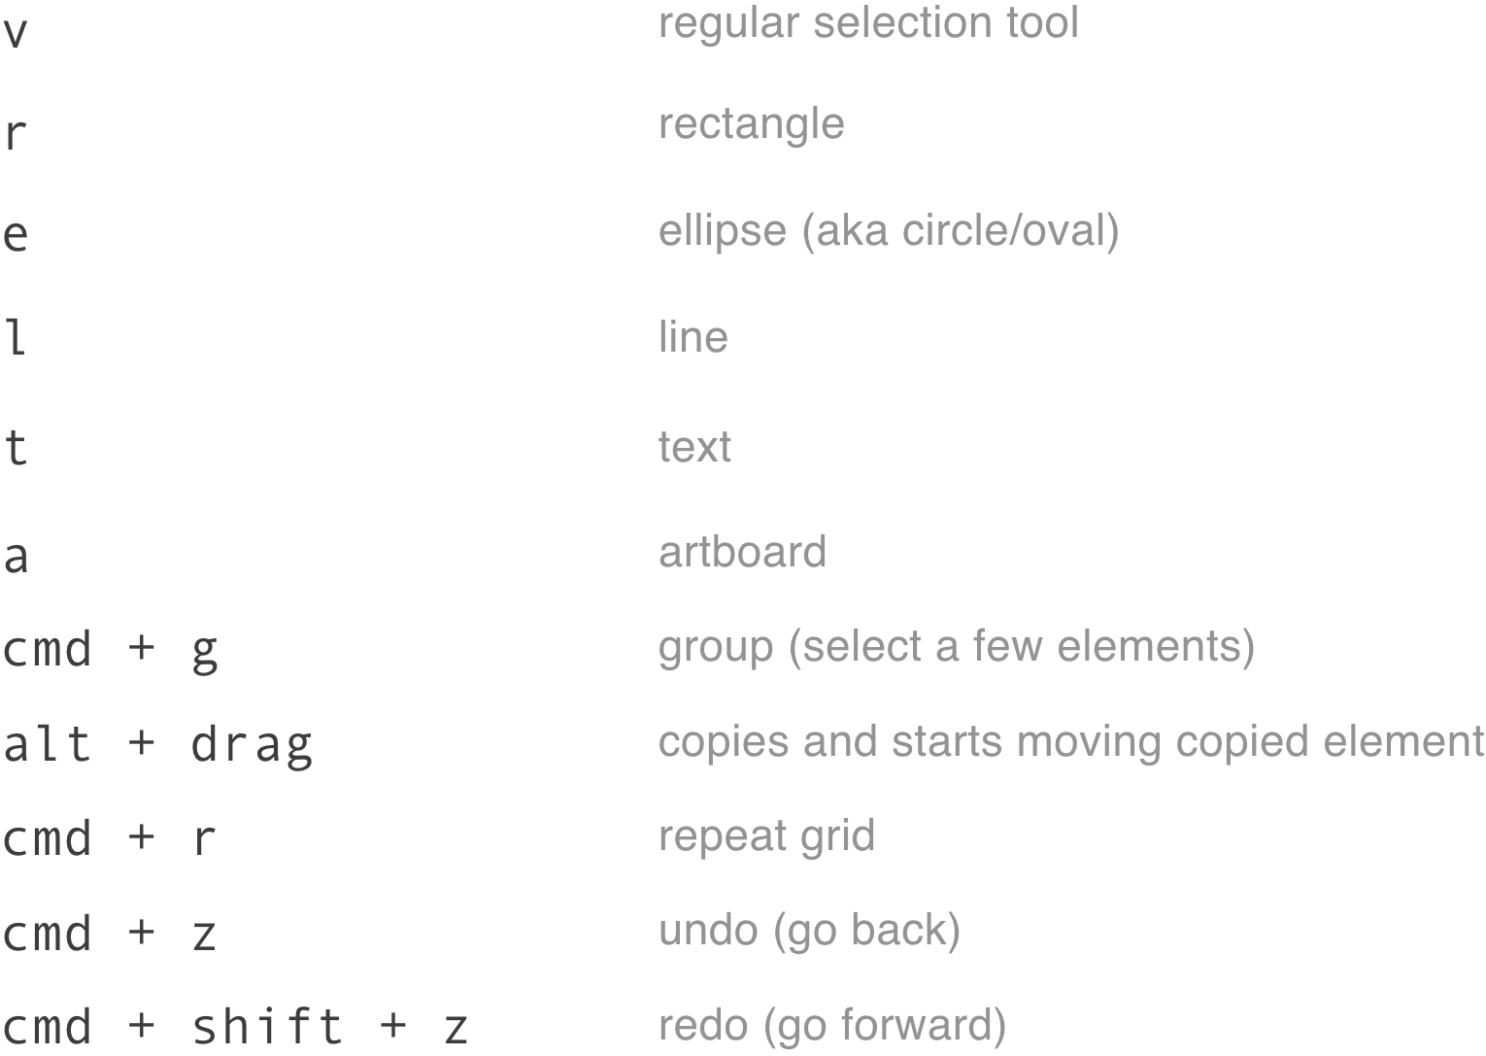
We’re becoming proficient in XD

Slide 8
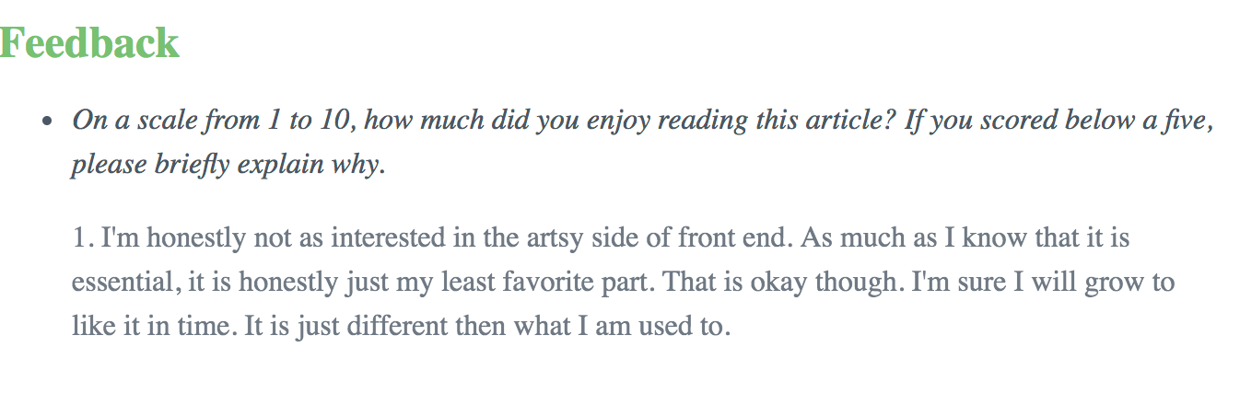
same tbh -- we love dissenting opinions (from hwk 5)

Slide 9
Rapid Prototyping
Rapid prototyping allows you to create digital mockups quickly.
Start with sketches, end with a prototype.
Use tools like Adobe XD, Figma, Sketch, etc. to create designs.

Slide 10
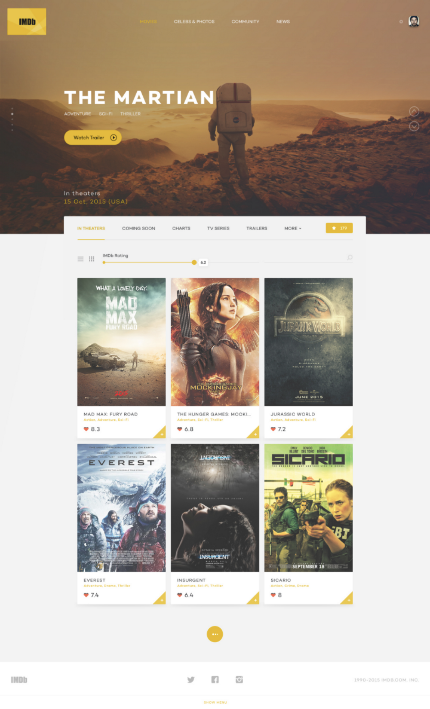
IMDB Redesign

Slide 11
Three things you’ll learn today
1). Modularizing your designs
via Grid Tool and Symbols

Slide 12
Three things you’ll learn today
2). Be able to look at UI analytically
and be mechanically
skilled to recreate them.

Slide 13
Three things you’ll learn today
3). Gain more confidence in
your proficiency as a designer,
regardless of your background

Slide 14
Getting Started

Slide 15

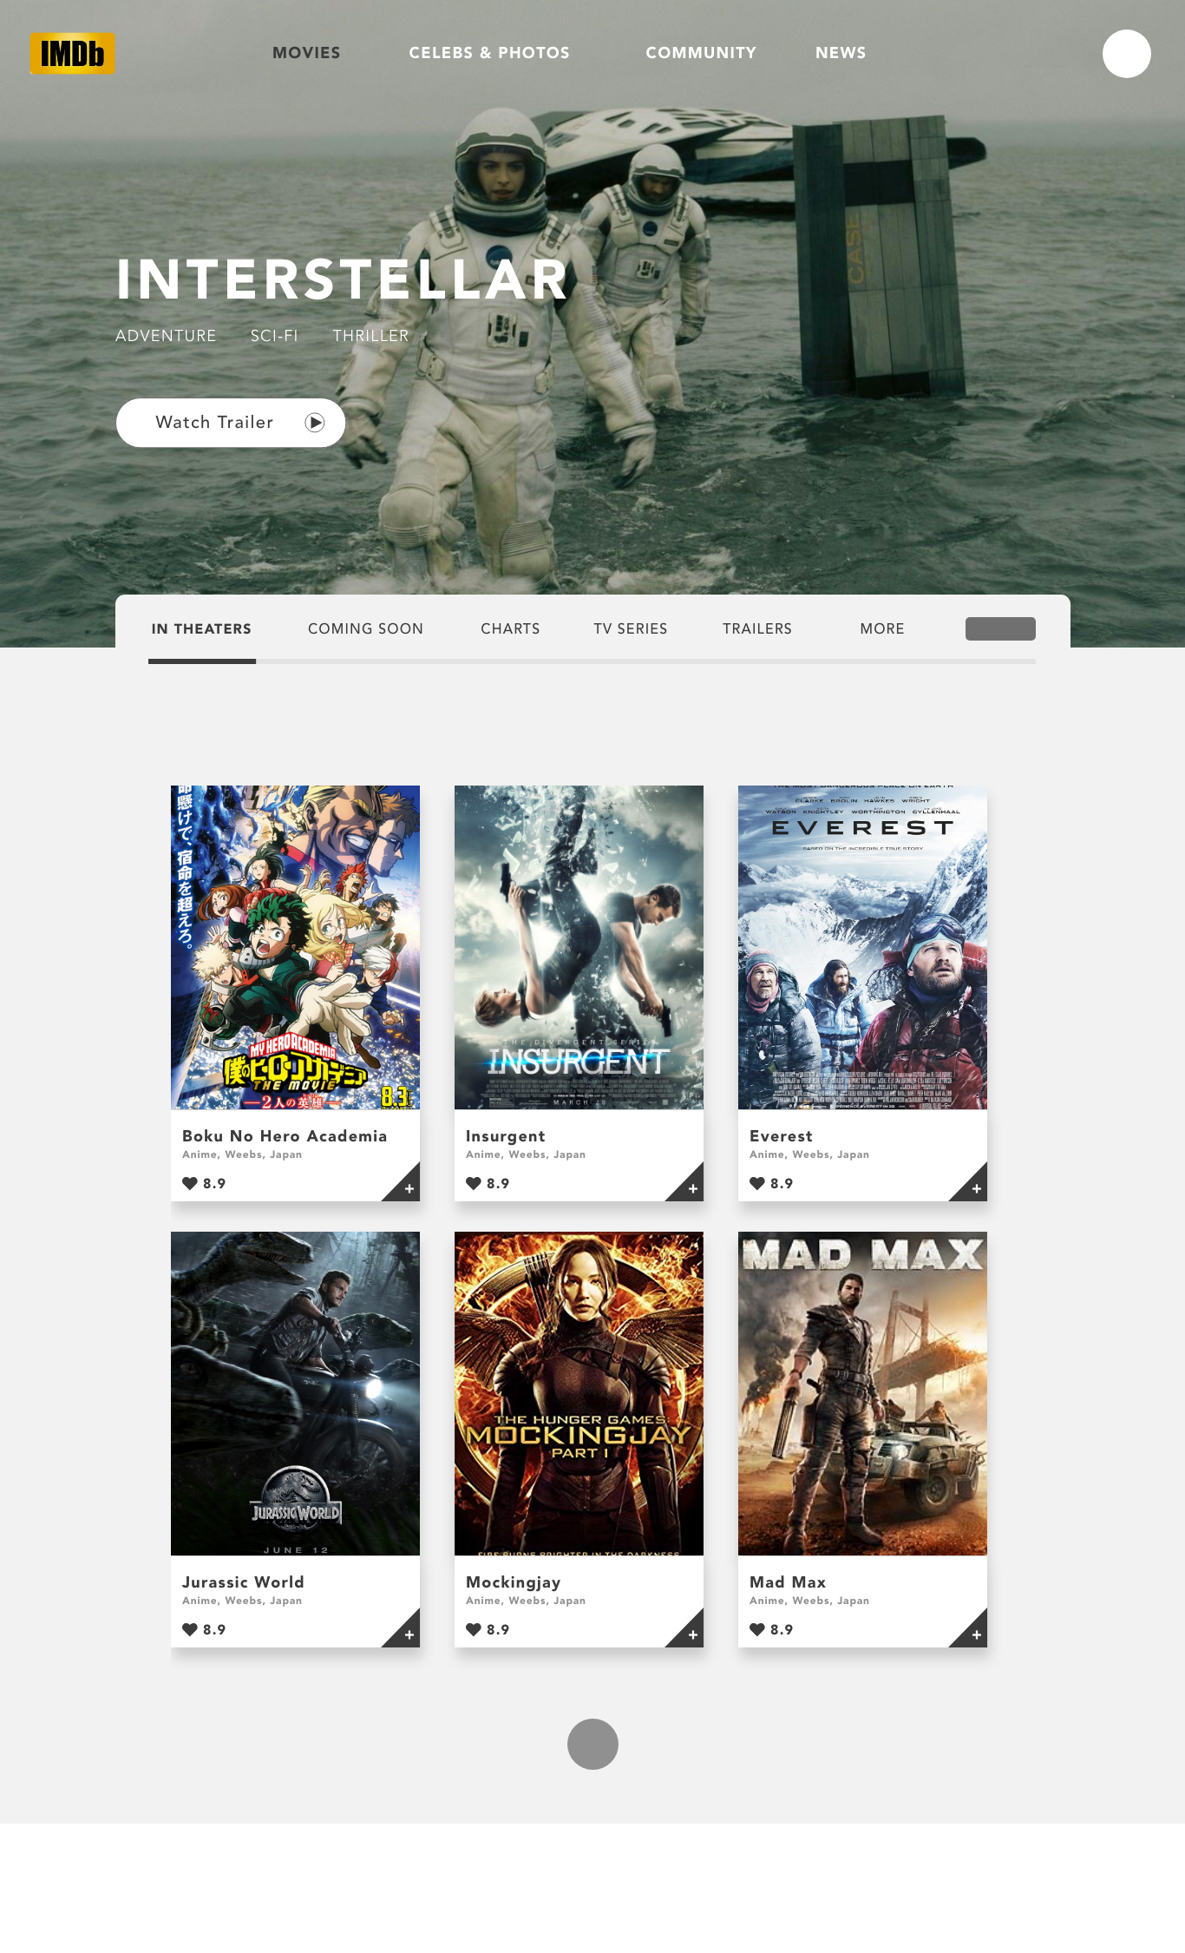
Analyze, Visualize, Design

Slide 16

Final Result - Any Questions?

